Slide 1
MEC 402 Casting, Welding and Forming
Dr. Arjyajyoti Goswami
arjyajyoti.Goswami@me.nitdgp.ac.in
+91-9953167384

Slide 2
Contents:
What is Weld Metallurgy
Different Zones in a fusion weld
Weld Metal Solidification
Epitaxial Growth
Competitive Growth

Slide 3
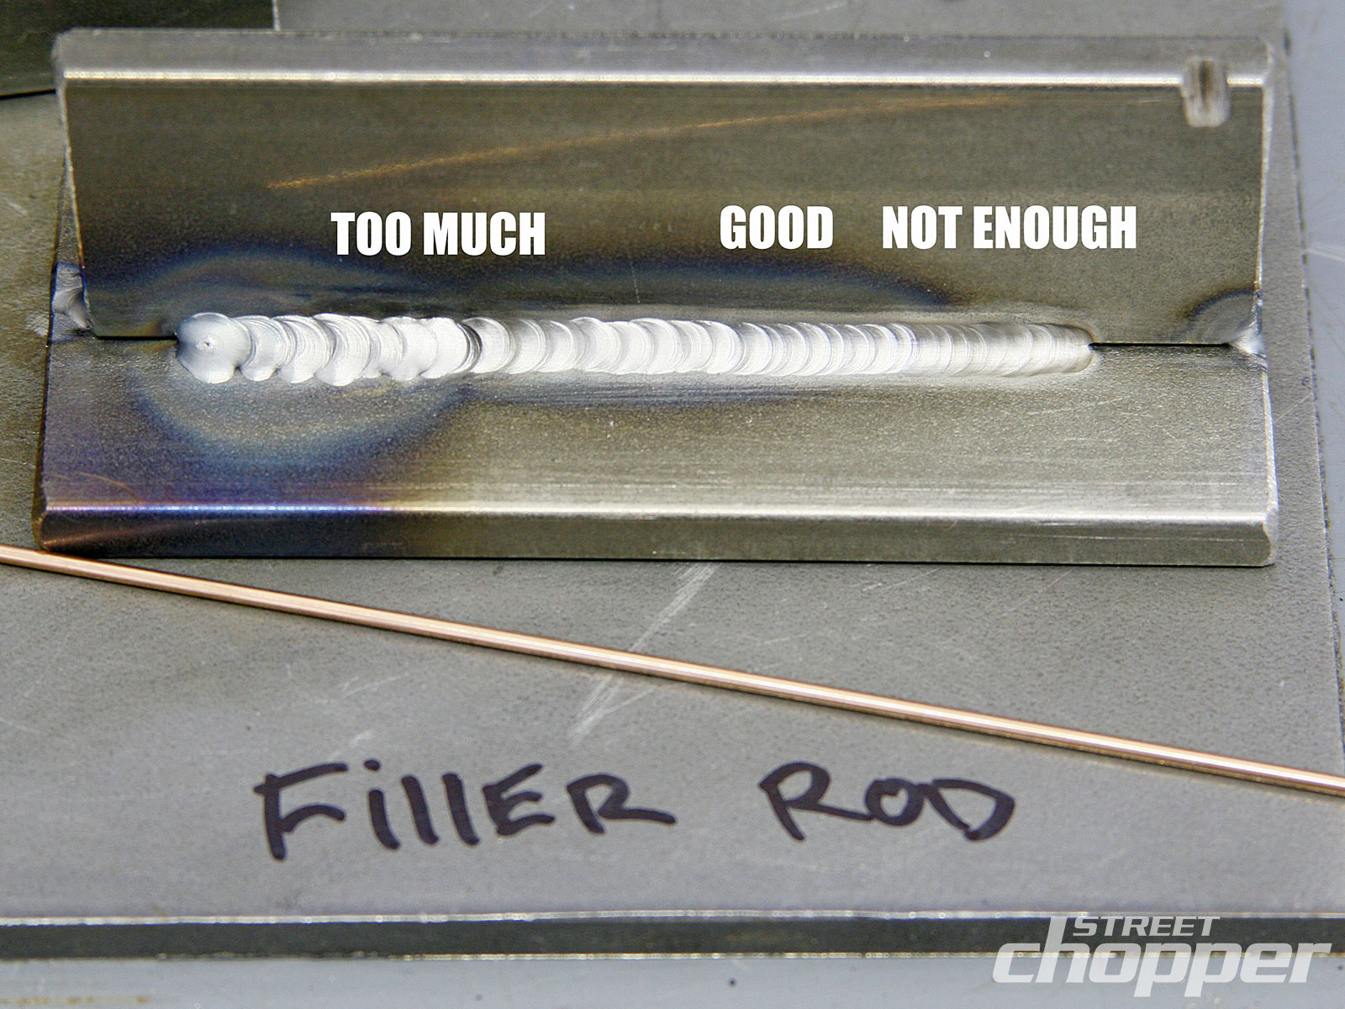
What is Weld Metallurgy
Weld Metallurgy deals with studying the changes in the base metal during the welding process and how it affects the mechanical properties of the final weld.
During Welding : The metal and the filler rod melts
gas-metal reactions takes place
surface phenomena changes happen
Molten metal from filler rod comes into the weld pool
and
then the metal solidifies with varying rates of cooling depending upon the heat input and also other factors like the thickness of the plate, thermal conductivity of the plate, design and geometry of the joint etc.
And this all happens very quickly and ultimately a welded joint is formed.
https://4.bp.blogspot.com/-BrDMpCv_nVk/UPfHndmAzeI/AAAAAAAAAK8/BLN9PZnJcTg/s1600/1009_stcp_10_z+tig_welding_steel_101+9.jpg
Notes:
Metallurgy is the science that explores why metals behave the way they do. It explains the properties, behavior and internal structure of metals.
Metallurgy also describes the treatments and processes that allow us to tailor a metal’s properties to a specific application.

Slide 4
Why study Welding Metallurgy ?
the overall-mechanical properties of a weldments are determined by the properties of individual microstructure present in the weld deposit and the weld heat affected zone.
Major problem associated with welding fabrication is the inability to obtain uniform mechanical properties through out the weldments.
Welding Metallurgy is concerned with
Melting of electrode and base metal
Solidification of weld metal
Gas absorption
Slag metal reactions

Slide 5
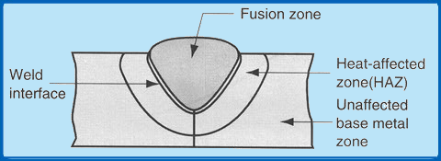
Zones in a fusion weld
A typical fusion welded joint varies in metallurgical structure from the fusion zone to the base material with consequential variations in mechanical properties. This is because of the fact that fusion welding processes result in melting and solidification with very high temperature gradient within a small zone with the peak temperature at the center of the fusion zone.
http://14.139.172.204/nptel/CSE/Web/112101005/images/fig4.3.1.png

Slide 6
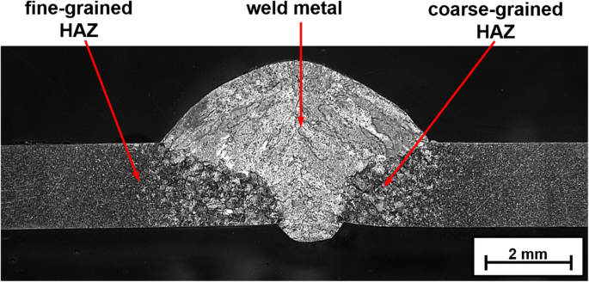
https://link.springer.com/article/10.1007/s40194-020-00856-9

Slide 8
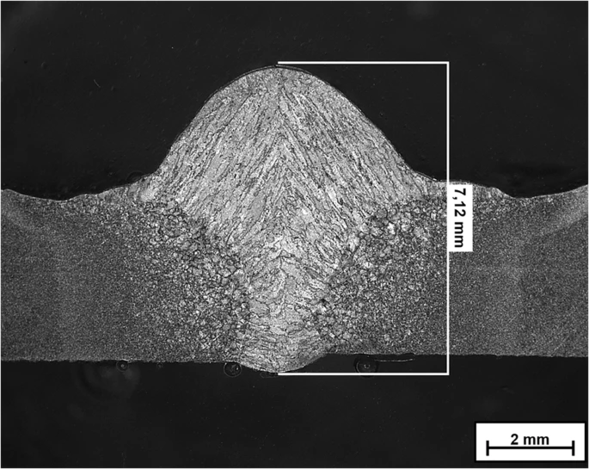
Widmansttaten Structure
https://link.springer.com/article/10.1007/s40194-020-00856-9

Slide 9
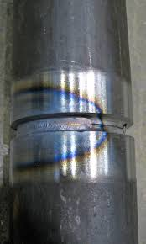
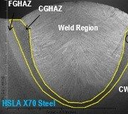
https://en.wikipedia.org/wiki/Heat-affected_zone
https://www.pinterest.com/pin/186477240804868061/

Slide 10
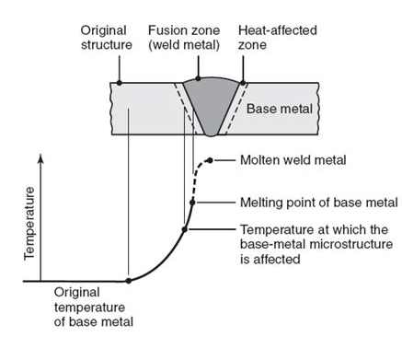
Fusion Zone / Weld Zone/ Weld Metal Zone
Weld Metal is formed as well as the weld metal solidifies from molten state. This is a mixture of parent metal and electrode (or filler metal). The ratio depends on welding process used, type of joint and plate thickness.
Weld Zone resembles a cast metal.
Similar to a casting process, the microstructure in the weld fusion zone is expected to change significantly due to remelting and solidification of metal at the temperature beyond the effective liquidus temperature.
The Weld Zone is highly homogeneous because of complete mixing.

Slide 11
Weld Interface
The weld interface, which is also referred to as mushy zone, is a narrow zone consisting of partially melted base material which has not got an opportunity for mixing. This zone separates the fusion zone and heat affected zone.
Improper mixing, because the forces responsible for mixing like the buoyancy force, surface tension gradient force, friction force etc. are not that pronounced in this region.

Slide 12
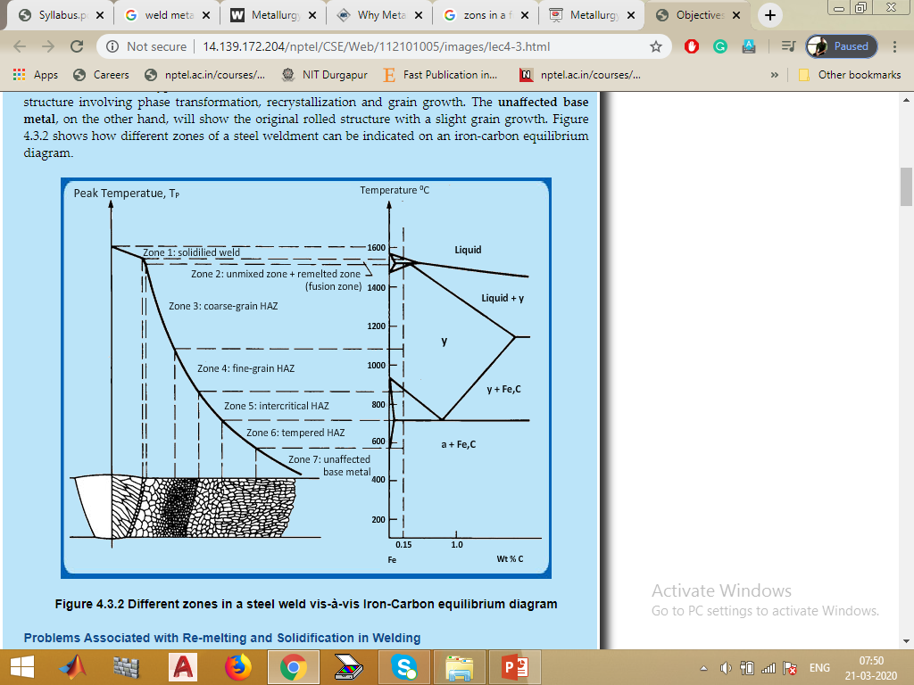
Heat Affected Zone
Adjacent to the Weld Interface is the HAZ.
HAZ is composed of the parent metal that did not melt but was heated to a high temperature for a sufficient period so that grain growth occurred.
Heat Affected Zone is that portion of base metal whose mechanical properties and microstructure have been altered by the heat of welding.
The width of HAZ varies according the welding process and technique.

Slide 13
The HAZ is subjected to a complex thermal cycle in which all temperatures from the melting range to much lower temperatures are involved and therefore the HAZ consists of a series of graded structures ringing the weld bead.
HAZ is the weakest region of the welded specimen except for the portions having obvious defects in the weld deposit. Also a job of an engineer is to reduce the HAZ as much as possible as it unnecessarily changes the properties of the base metal.

Slide 14
Grain growth region
Immediately adjacent to the weld interface.
The temperatures in this zone has reached well above the upper critical temperature so that grain growth has occurred and grain coarsening has occurred.
Grain refined region
Around middle of HAZ.
The temperature is just above the upper critical temperature and such that grain refinement is complete but the refined grains did not get a chance to grow hence this region has the smallest grain size.
Grain transition region
Temperature is below upper critical temperature and partial recrystallization takes place.

Slide 15
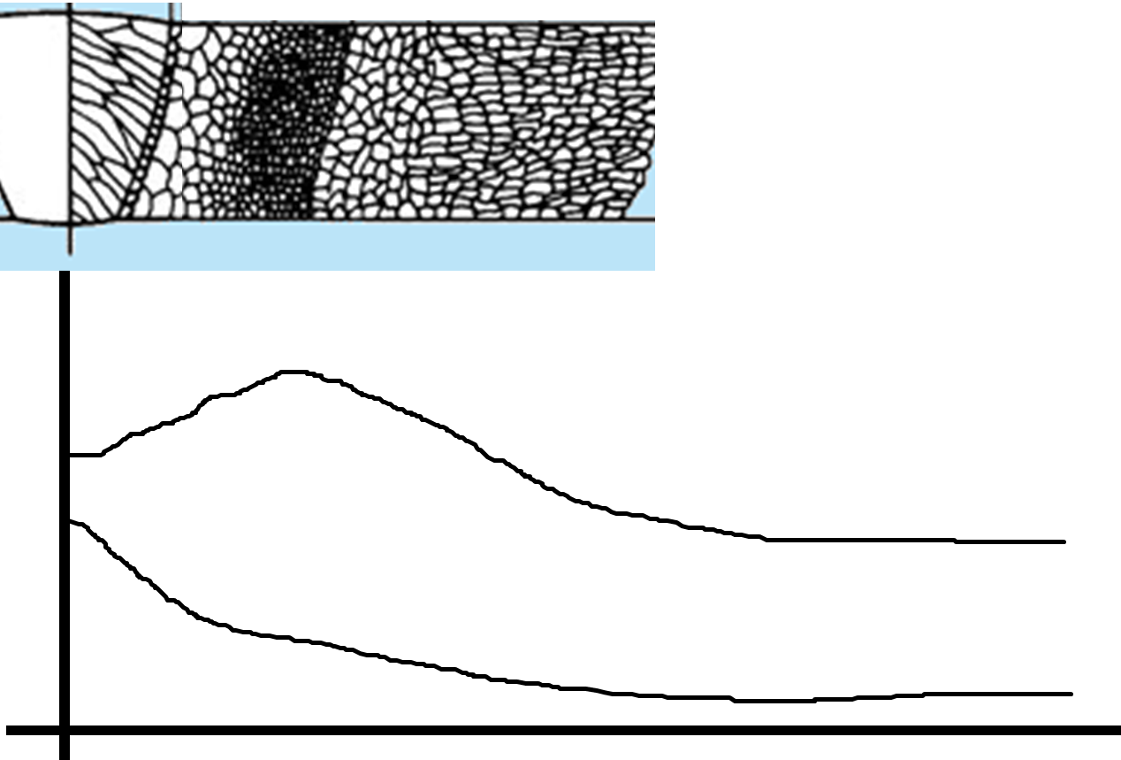
Hardness
Temperature
Distance from weld center

Slide 16
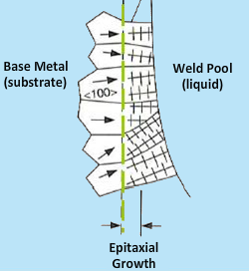
Epitaxial Solidification
Existing solid grains (partially melted) at the liquid-solid interface in a fusion weld serves as a ready made nuclei from which grain growth may occur.
Such type of solidification is called Epitaxial Solidification.
The growing grain will have same orientation as the grain from which it is growing but adjacent grains may have different orientation.

Slide 17
Competitive Growth
The grain which is oriented in the direction of maximum heat dissipation and those which are better oriented in a direction in which growth is more favourable will grow at the expense of its neighbouring grains and such type of Grain Growth is called as Competitive Growth.
For example, F.C.C and B.C.C materials have <100> as their preferred growth direction.

Slide 18
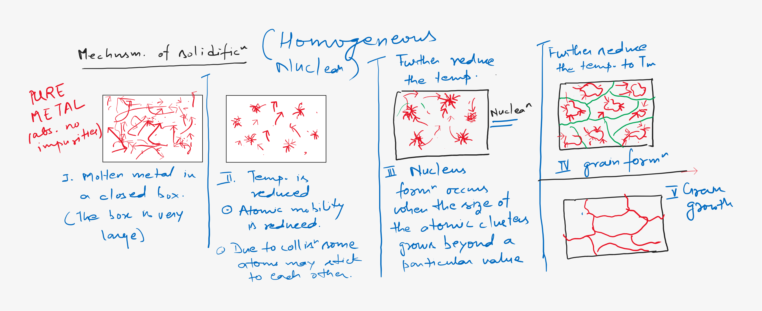

Slide 19
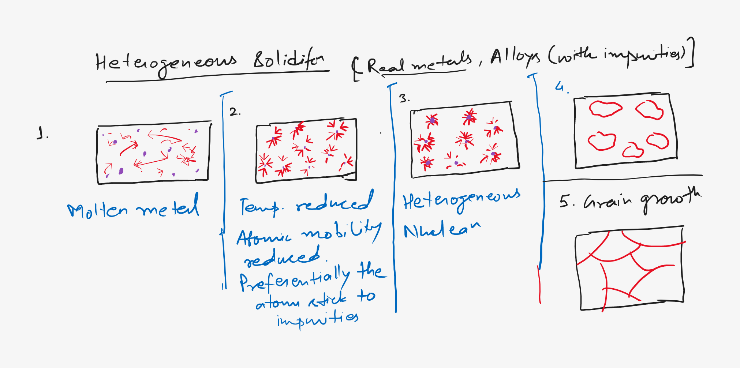

Slide 22


